Slide 1
Min Graph Coloring Approximation Solution
John Curley

Slide 2
How The Approximation Works

Slide 3
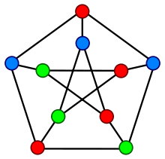
Not Always Optimal
The Graph to the right’s optimal solution is 3 however in our approximation the yielded solution ends up being 7

Slide 4
Run Time Results (Scripts)

